Slide 1
FACIAL EMOTION DETECTION
Image Processing (CSE4019) J COMPONENT REVIEW 3
Submitted To Prof Swathi J N
ZATAKIYA DEEP 18BCE0090
SOUMYA VISHWAKARMA 18BCB0086

Slide 2
Acknowledgment
This is to articulate our deepest gratitude and joy at being bestowed upon with an opportunity to get a project on “Facial Emotion Detection”. We would like to thank all the authors of review reports who have previously worked on related research papers. We would avail this opportunity to express our profound gratitude and indebtedness to Prof. Swathi J N for giving us the opportunity to explore and learn about Image Processing and Automation under her guidance. Lastly, we would also like to thank the sources studying through which we could learn the insights of dealing with image processing.

Slide 3
Introduction
Objective:
Realtime detection of the face and interpreting different facial expressions like happy, sad, angry, afraid, surprise, disgust, and neutral using image processing.

Slide 4
Motivation:
Humans often have different moods and facial expressions changes accordingly. Human emotion recognition plays a very important role in social relations.
The automatic recognition of emotions has been an active analysis topic from early eras. In this deep system user’s emotions using its facial expression will be detected.
An automatic facial expression recognition system has to perform detection and site of faces during a cluttered scene, facial feature extraction, and facial expression classification.
This system has ability to monitor people emotions, to discriminate between emotions and label them appropriately and use that emotion information to guide thinking and behavior of particular person

Slide 5
Project Specification & Goals
Emotion recognition methods can be divided into two main groups:
• First group work on static images and second one work on dynamic image sequences. In the static approaches, temporal information is not considered and they just use current image information, while in the dynamic approaches images temporal information used in order to recognize expressed emotion in frame sequences.

Slide 6
• Automatic emotion expression recognition includes three steps: face image acquisition, feature extraction, and facial emotion expression recognition. In the optimal extracted features, with in class variations of expression should be minimum while between-class variations should be maximum. If the extracted features are not suite for task in hand and do not have enough information, even the best classifier may be unsuccessful to have best performance.
Feature extraction for emotion recognition can be divided into two approaches: Geometric featurebased methods and appearance-based methods. In the first methods, location and shape of parts of the face such as eyes, mouth, eyebrows and nose are considered, while in the second methods, particular regions or whole of face are considered.

Slide 7
Technical Specification
This project runs on top of a Convolutional Neural Network (CNN) that is built with the help of Keras whose backend is TensorFlow in Python.
We have taken spider environment to run the code.
In this project, we used a dataset provided by Kaggle website, which consists of about 37,000 wellstructured 48 × 48 pixel grayscale images of faces.
The images are processed in such a way that the faces are almost centered and each face occupies about the same amount of space in each image.

Slide 8
Each image has to be categorized into one of the seven classes that express different facial emotions. These facial emotions have been categorized as: 0=Angry, 1=Disgust, 2=Fear, 3=Happy, 4=Sad, 5=Surprise, and 6=Neutral.
In addition to the image class number (a number between 0 and 6), the given images are divided into three different sets which are training, validation, and test sets.

Slide 9
Approach
Our project code setup consists of the following steps:
• Detection of face through webcam. We have used OpenCV for image processing tasks where we identify a face from a live webcam feed.
• Eliminating the background for better performance.
• Detection the facial coordinates and happy it in the datasets.
• The facial emotions that can be detected and classified by this system are Happy, Sad, Anger, Surprise and Neutral.

Slide 10
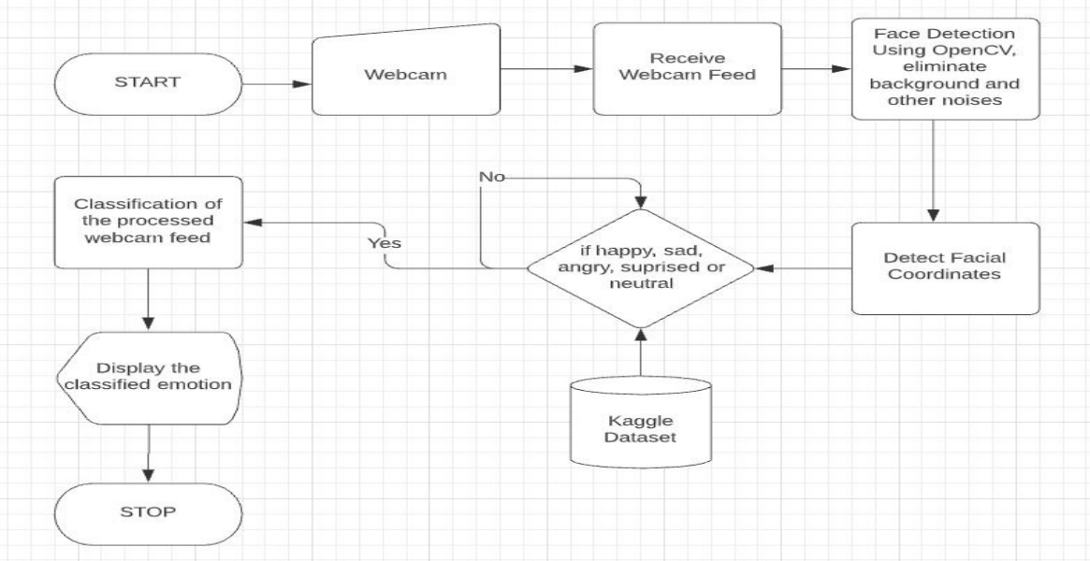
Model

Slide 11
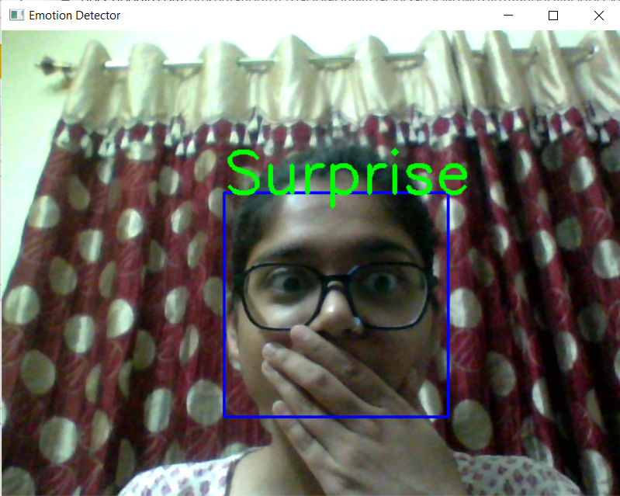
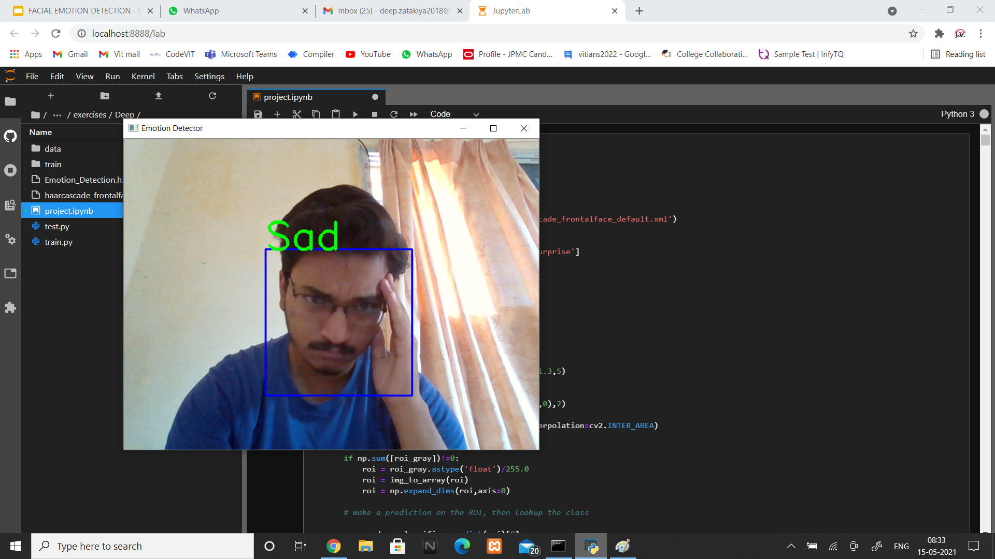
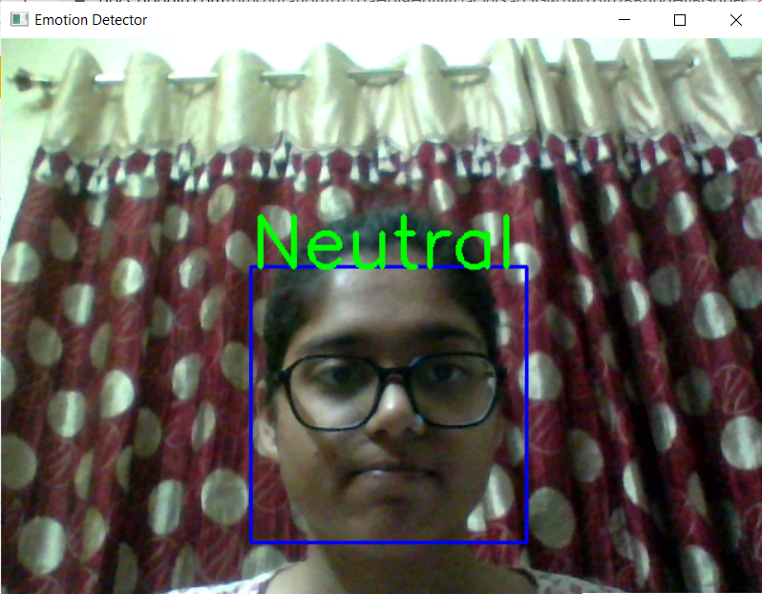
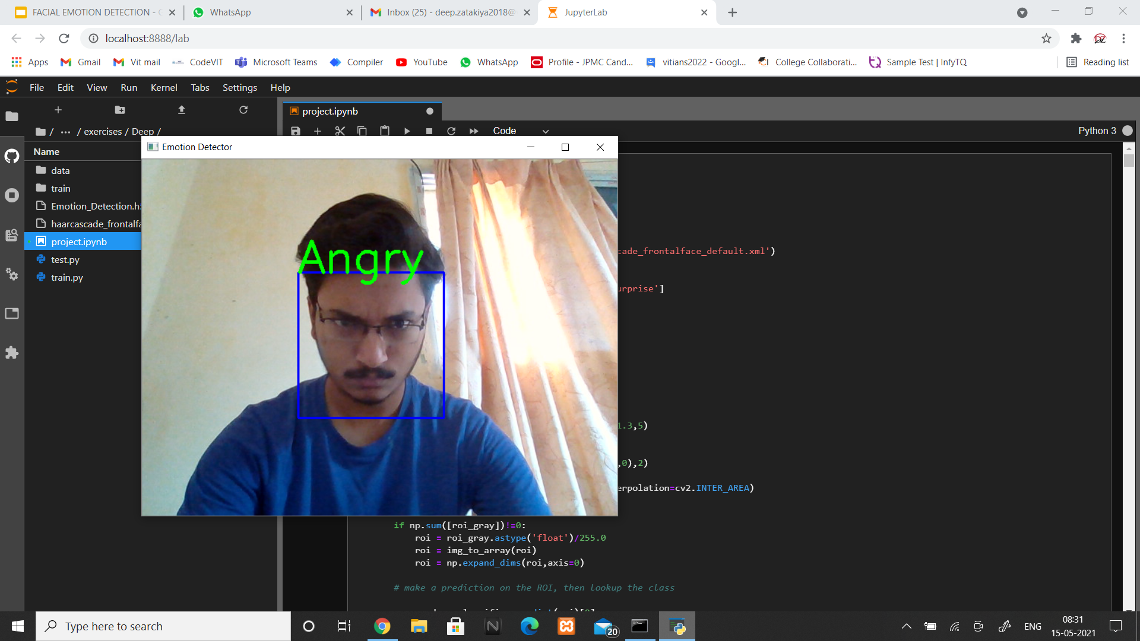
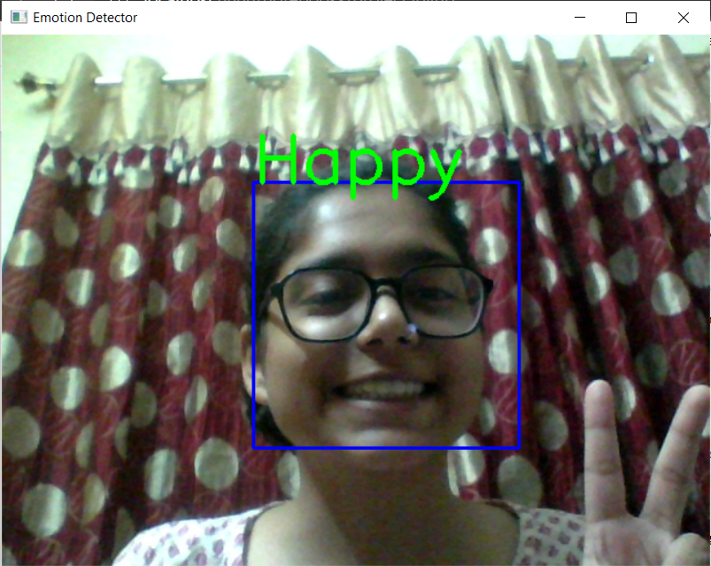
Implementation

Slide 12


Slide 13
Challenges
The accuracy of the facial detection system will grossly depend on the number of images in the training dataset. As explained before, we have chosen Kaggle Dataset consisting of 28,709 training images. Therefore, we expect a fairly accurate result.
The resolution of the camera used to extract the video of the user is also essential for the accuracy. Our project uses a webcam. Therefore, we have a pre-processing stage where the background noises will we removed to improve accuracy.
Even an accurate facial emotion recognition may not give us an insight on the person's thought as sometimes they can be feigned.

Slide 14
Result
From the above demonstration presented, we have seen how the facial emotion is detected. To see how well our model has fared, we took into consideration the accuracy. In our project, we measured 3 accuracy methods.
Accuracy is measured as correctly predicted class out of all the testing cases. This one is called the standard accuracy formula. It uses false positives, true positives, false negatives and true negatives.
The second method we have used is called the prevalence accuracy which is another diagnostic test which uses sensitivity and specificity.
The third method is called percent error which takes into consideration the observed values and the values that are accepted as truth. It informs us about the accuracy of the reading and how much the observed values derives from the truth. The following images are the results observed for each of the images.

Slide 15
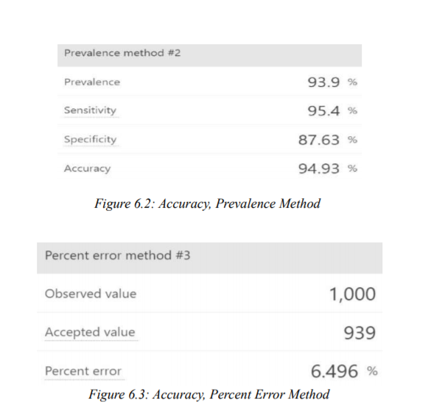
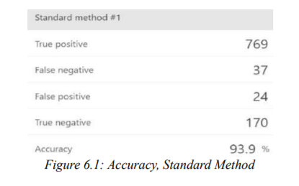
The following images are the results observed for each of the images.

Slide 16
Over all, our conclusion is that we have built a considerably accurate model based on the percentages that are all 90+ for the first two methods. For the percentage error method, the smaller the percentage derived, the better the accuracy.
Therefore, even by this measure our model is fairly accurate. I
n this project user’s emotions using its facial expression will be detected. Real-time detection of the face and interpreting different facial expressions like happy, sad, angry, afraid, surprise, disgust, and neutral etc.
An automatic facial expression Recognition system will perform detection and site of faces during a cluttered scene, facial feature extraction, and facial expression classification. It provides a proposed model to solve the problems of emotion recognition based on facial recognition in virtual learning environments, and the efficiency and accuracy are considered at the same time.
This system has ability to monitor people emotions, to discriminate between emotions and label them appropriately and use that emotion information to guide thinking and behaviour of particular person

Slide 17
References
• https://www.ncbi.nlm.nih.gov/pmc/articles/PMC5856132/
• https://www.researchgate.net/publication/227031714_Facial_ Expression_Recognition
• http://cs231n.stanford.edu/reports/2016/pdfs/023_Report.pdf
• https://www.ijert.org/research/effective-emotion-recognitionof-expressions-from-facial-featuresIJERTCONV5IS06002.pdf
• https://www.mdpi.com/1424-8220/18/2/40 • https://www.ijeat.org/wp-content/uploads/papers/v8i6S/F10190886S19.pdf
• https://www.irjet.net/archives/V3/i2/IRJET-V3I284.pdf
• https://www.ncbi.nlm.nih.gov/pmc/articles/PMC5856132/ • https://arxiv.org/pdf/1910.05602.pdf
• https://link.springer.com/article/10.1007/s12652-017-0636-8 • https://link.springer.com/article/10.3758/s13428-017-0996-1
• https://www.researchgate.net/publication/332518418_Emotion_recognition_from_facial_expression_using_deep_convolutional_neural_network
• https://www.researchgate.net/publication/320402070_Enhancing_CNN_with_Preprocessing_Stage_in_Automatic_ Emotion_Recognition
• https://www.researchgate.net/publication/332783468_Fuzzy_Emotion_Recognition_Using_Semantic_Facial_Featu res_and_Knowledge-based_Fuzzy
• https://www.researchgate.net/publication/332783468_Fuzzy_Emotion_Recognition_Using_Semantic_Facial_Featu res_and_Knowledge-based_Fuzzy
• https://www.researchgate.net/publication/343921384_Feature_Selection_on_2D_and_3D_Geometric_Features_to_ Improve_Facial_Expression_Recognitio

Slide 18
THANK YOU
Image Processing (CSE4019) J COMPONENT REVIEW 1
Submitted To Prof Swathi J N
ZATAKIYA DEEP 18BCE0090
SOUMYA VISHWAKARMA 18BCB0086

